Slide 1
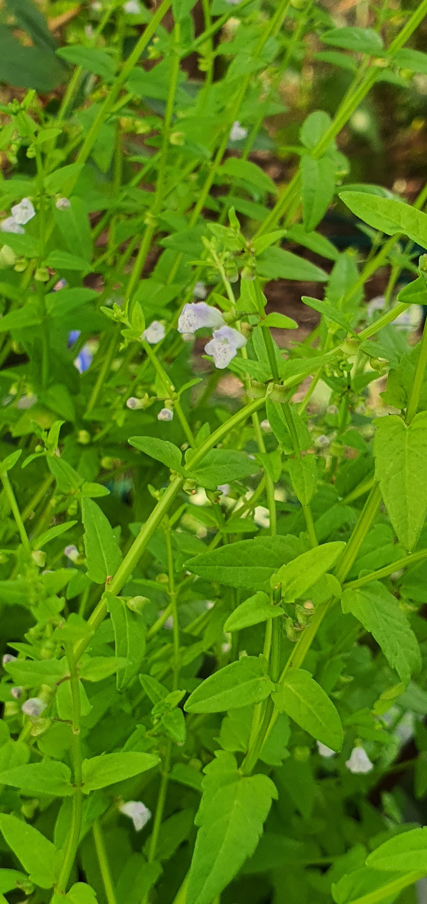
An analysis of phytochemical diversity in Scutellaria to identify species with medicinal potential
Bryce Askey¹, Yeong Hun Song¹, Yoonkyung Lee², Ru Dai¹, Tong Geon Lee^{1,3,4}, Sangtae Kim², and Jeongim Kim^{1,3}
¹Horticultural Sciences Department, University of Florida, Gainesville, FL, USA
²Department of Biology, Sungshin Women’s University, Seoul, Republic of Korea
³Plant Molecular and Cellular Biology Graduate Program, University of Florida, Gainesville, FL, USA
⁴Gulf Coast Research and Education Center, University of Florida, Wimauma, FL, USA
Scutellaria dependens

Slide 2
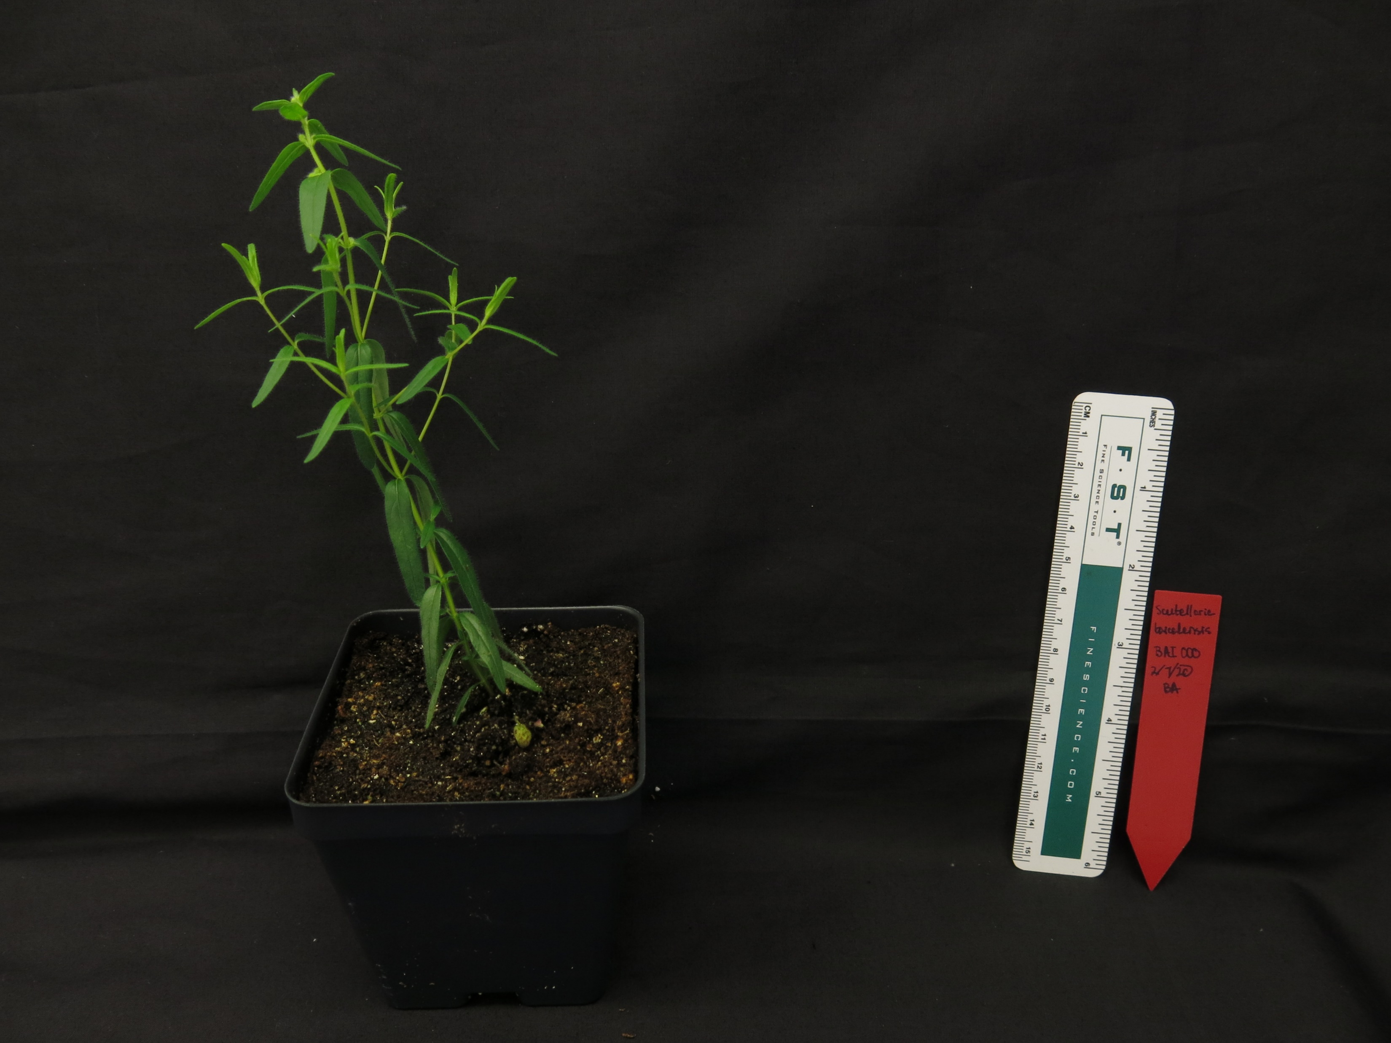
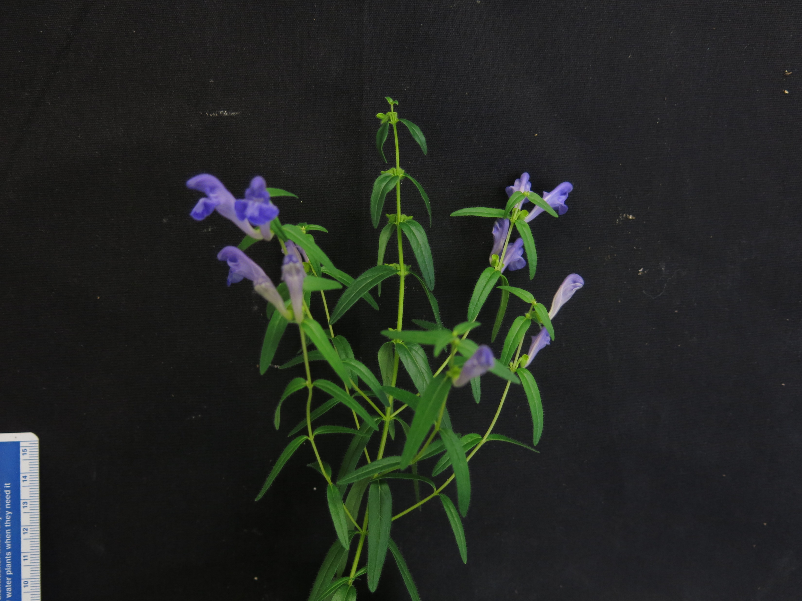
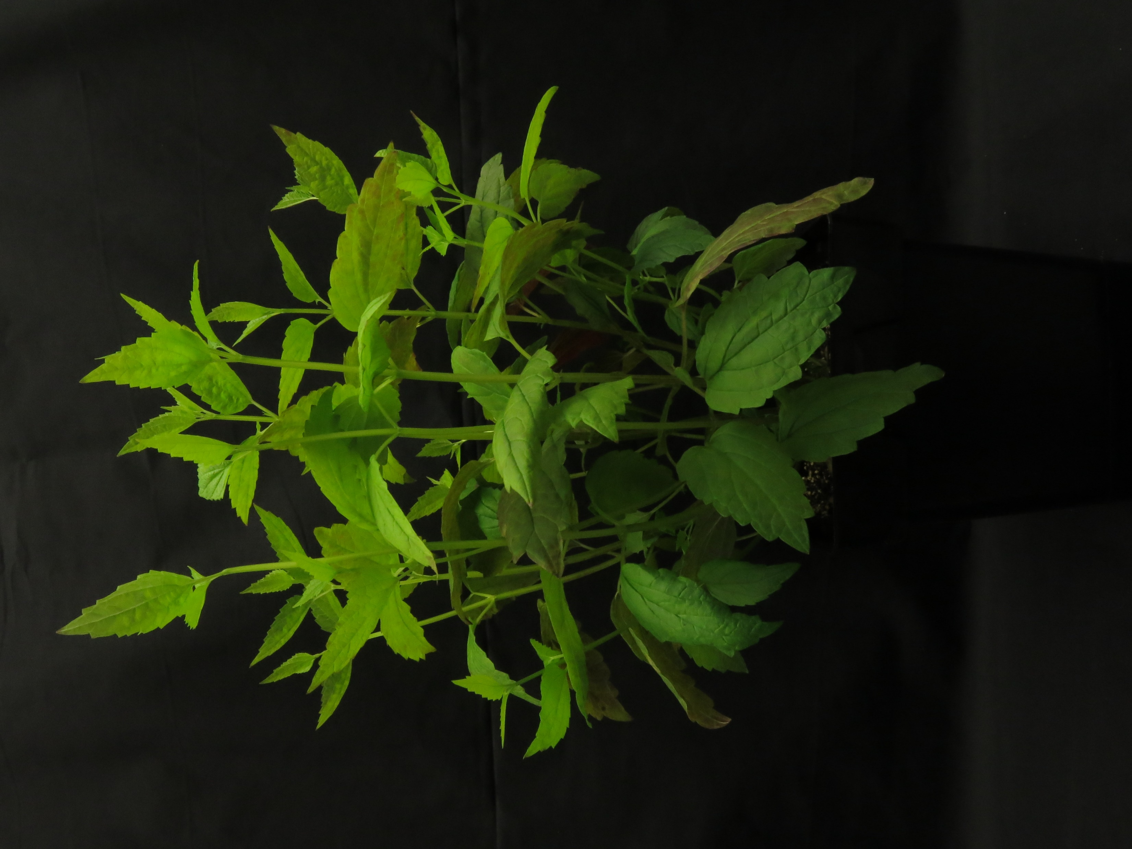
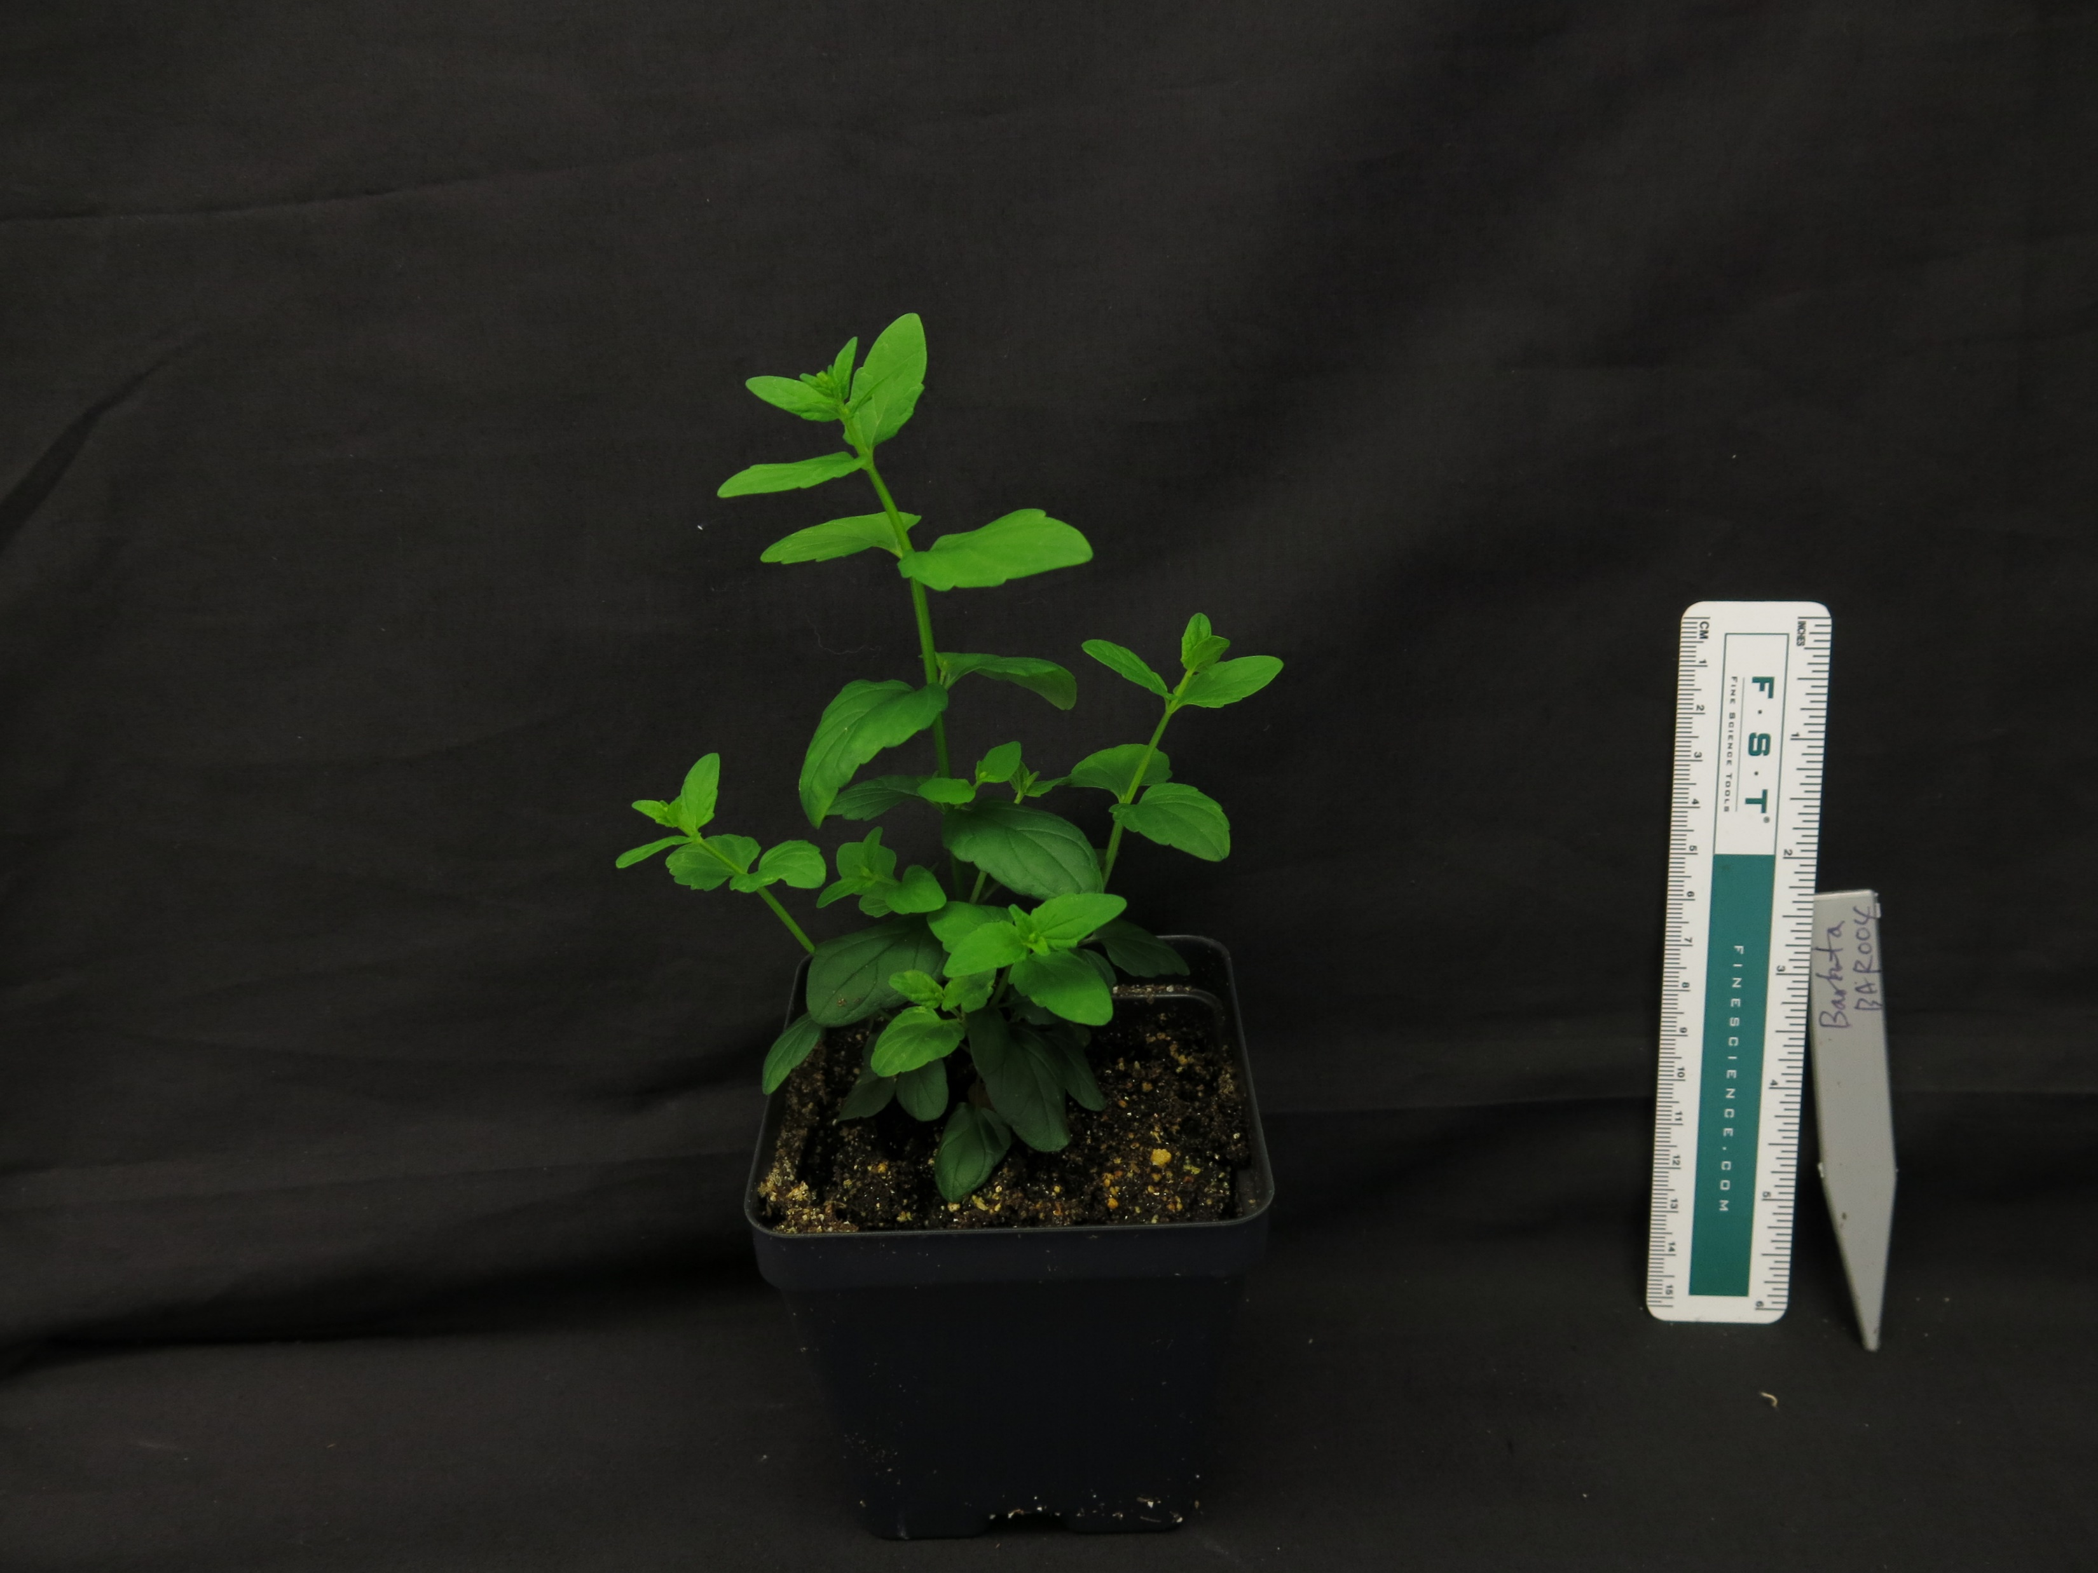
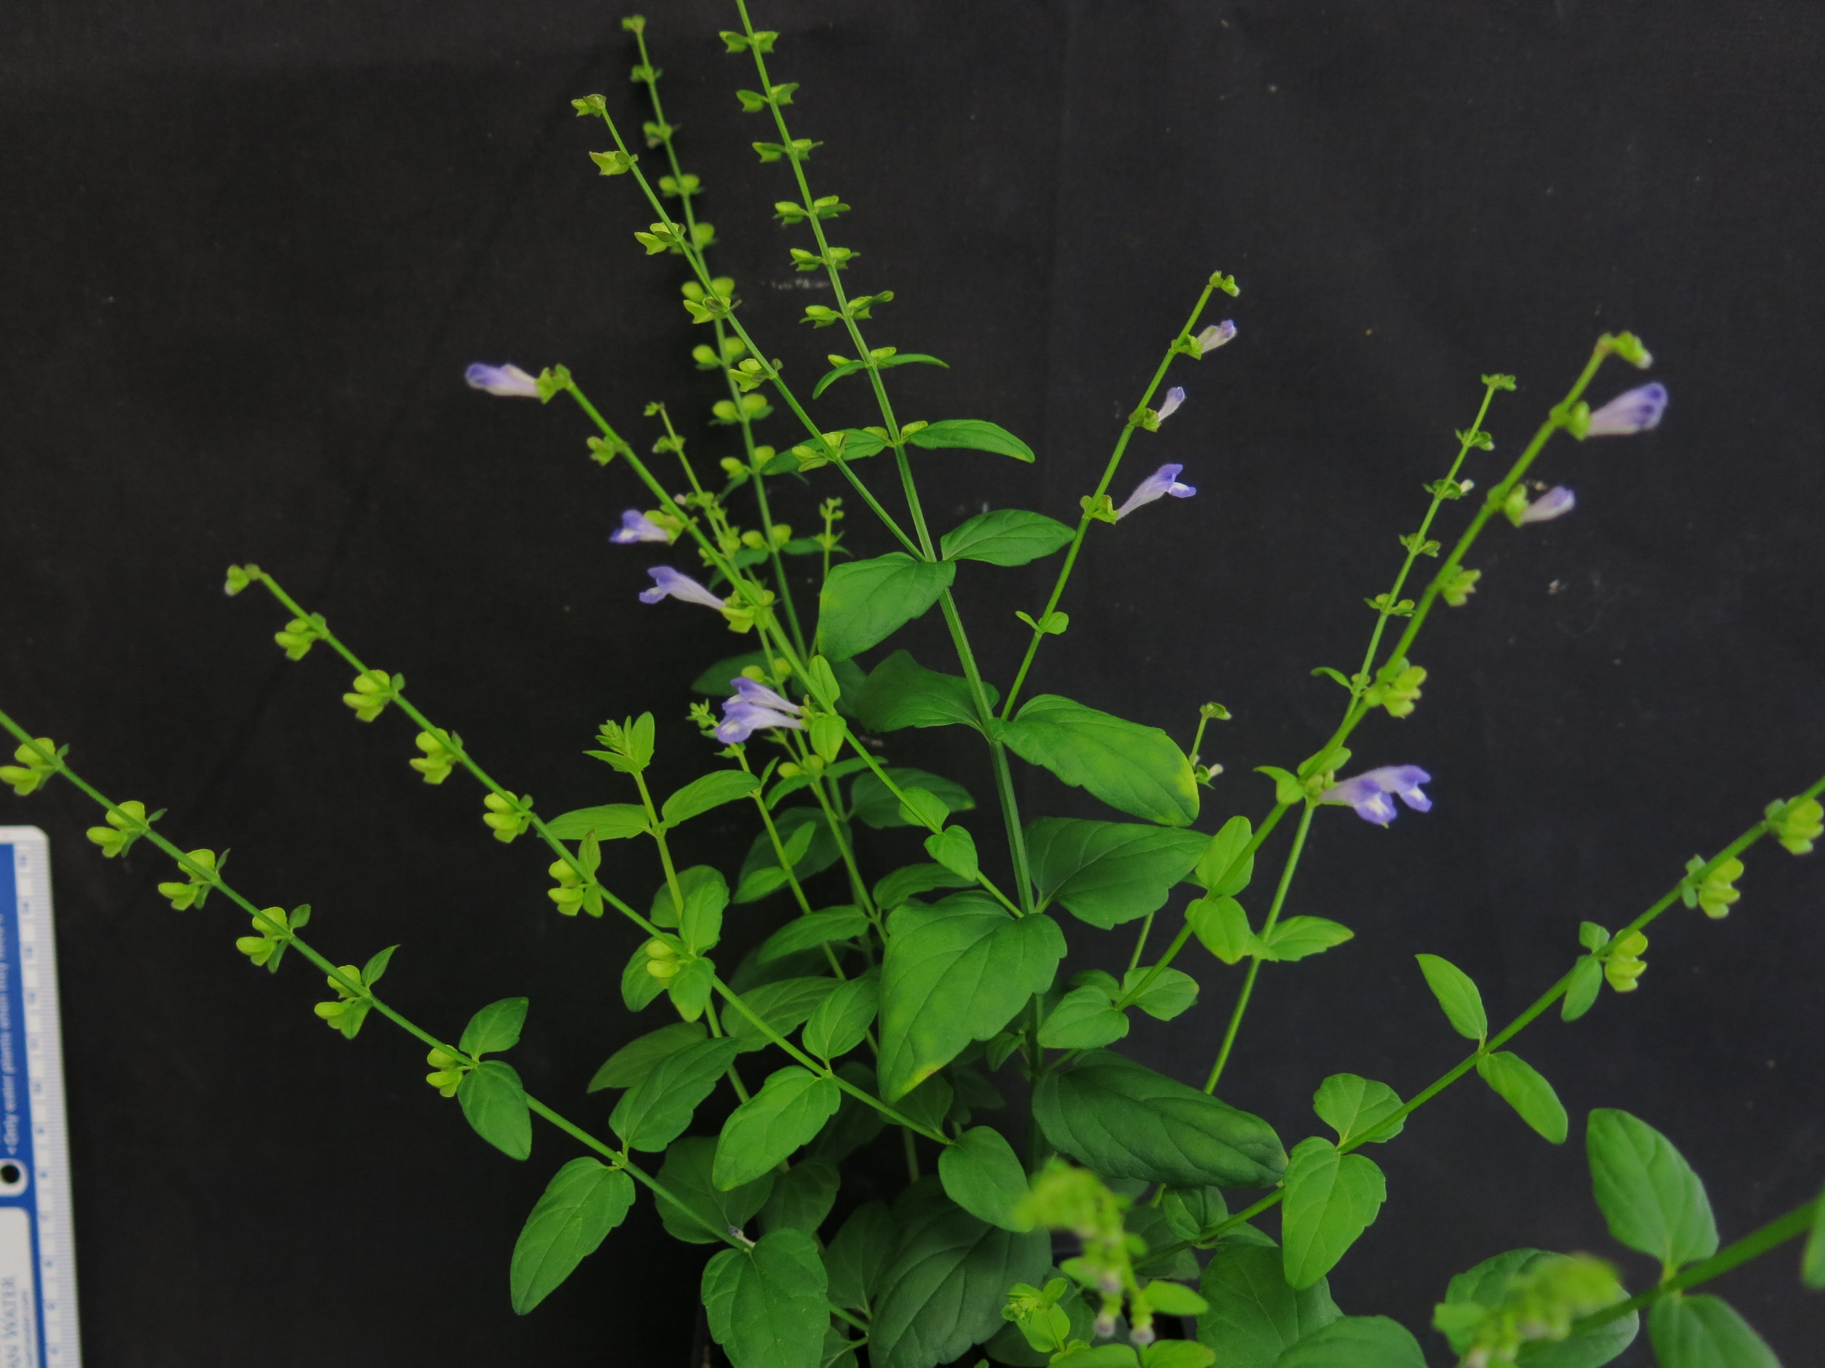
Introduction to the Scutellaria genus
Part of the Lamiaceae family
Rich in medicinal flavonoids
Several species more well-studied because of their medicinal uses
Baicalein | Antitumor, hepatoprotective, & more
Wogonin | Anti-inflammatory, anxiolytic, & more
Oroxylin A | Neuroprotective, & anti-RSV
Scutellarein | Anti-RSV
S. baicalensis
S. lateriflora
S. barbata

Slide 3
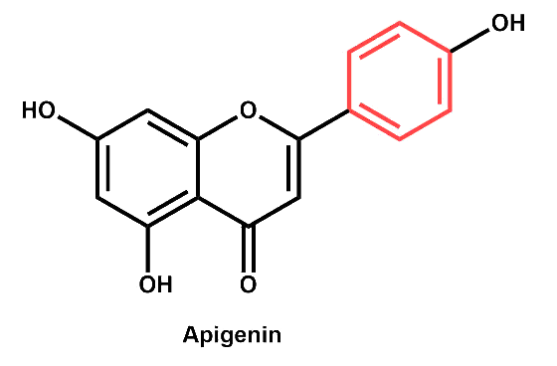
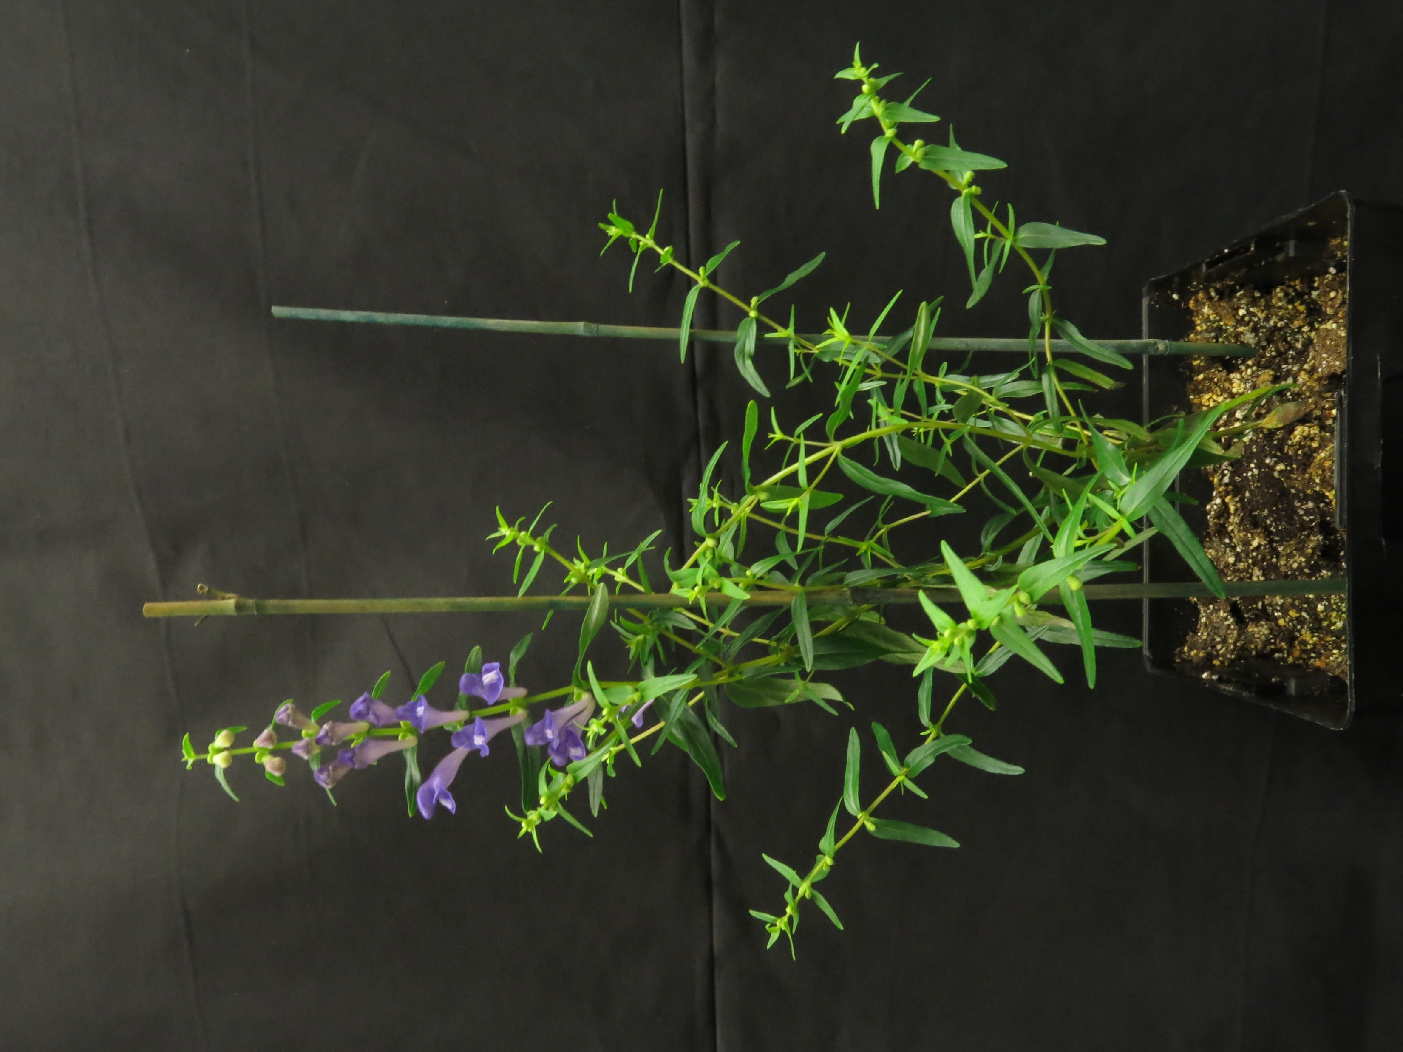
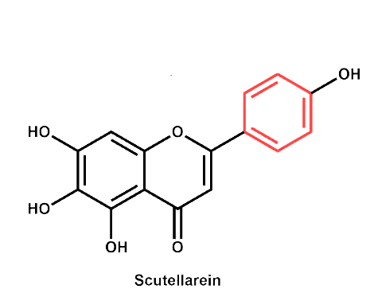
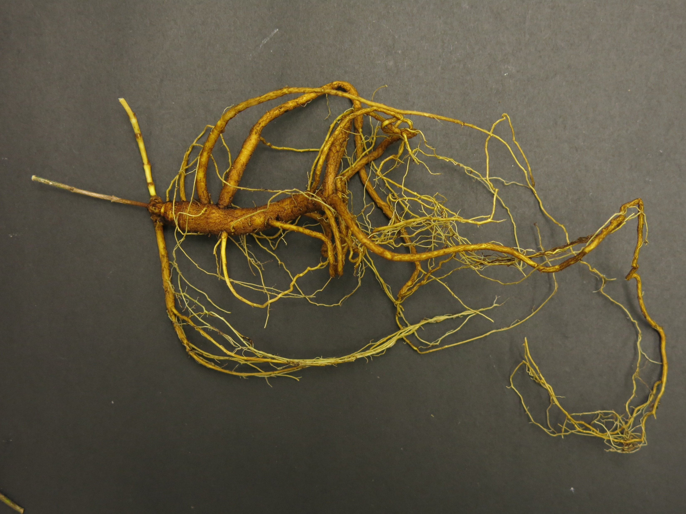
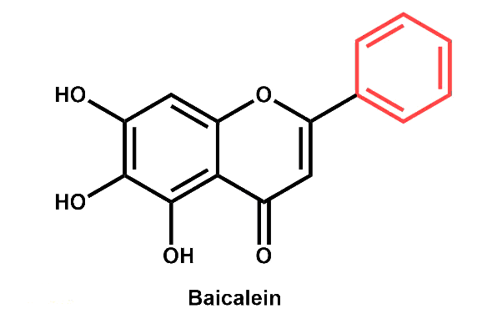
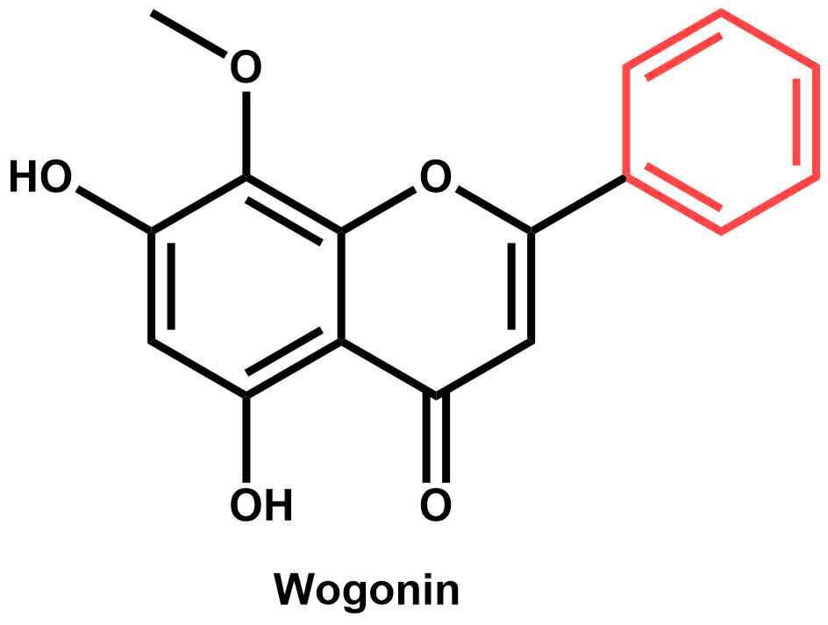
Scutellaria baicalensis
Apigenin
Most famous species
Used often in eastern medicine – Huang Qin
Unique flavonoid profiles observed
Some specific to roots, and some to shoots
Organ-specific biosynthetic pathway proposed by Zhao et al. (2019)
Scutellarein
Baicalein
Wogonin

Slide 4
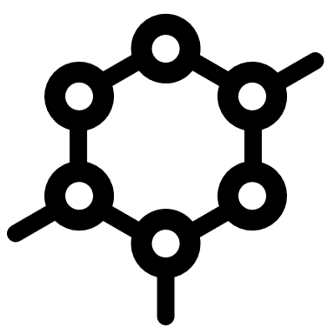


Scutellaria contains >470 species
Extent of flavonoid profile similarity is largely unknown
A better understanding of flavonoid diversity in Scutellaria would: |  | 1) Reveal interspecific differences in the underlying biosynthetic pathway
 |  | 2) Better characterize the evolutionary history of the biosynthetic pathway in the genus
 |  | 3) Help identify candidate species for biotechnology applications

Slide 5
Overview of method
Chemically assay a large set of Scutellaria species
Collect genome size data for a subset of species
Compare to phylogenetic data
Compare to phylogenetic data
Perform organ-specific chemical profiling on a subset of species
Compare to proposed biosynthetic pathway for S. baicalensis
Compare to phylogenetic data

Slide 6
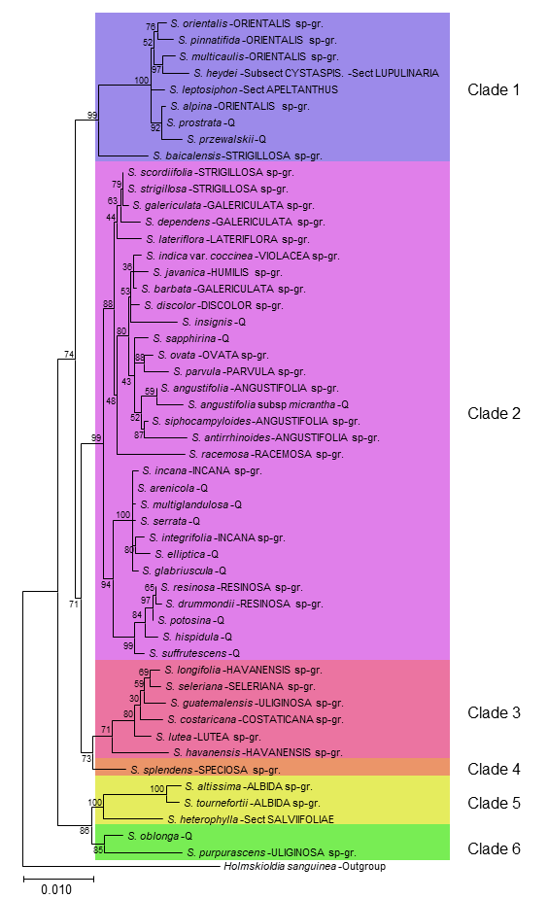
Phylogenetic tree
Constructed from chloroplast genomes of 52 species of Scutellaria
22 out of 38 species-groups represented
Separated into 6 clades for downstream comparison

Slide 7
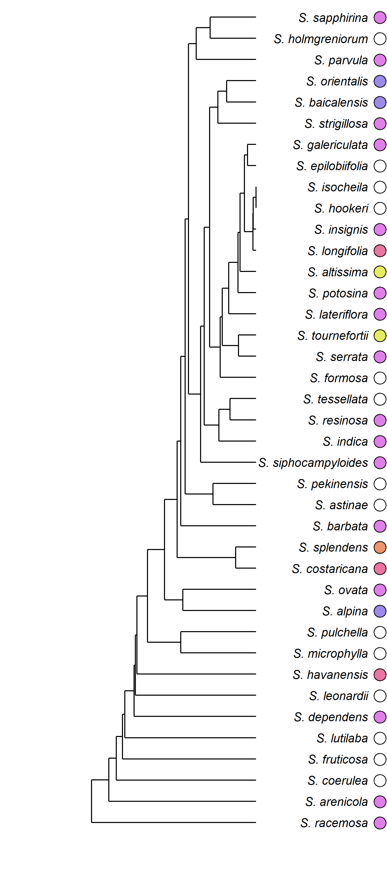
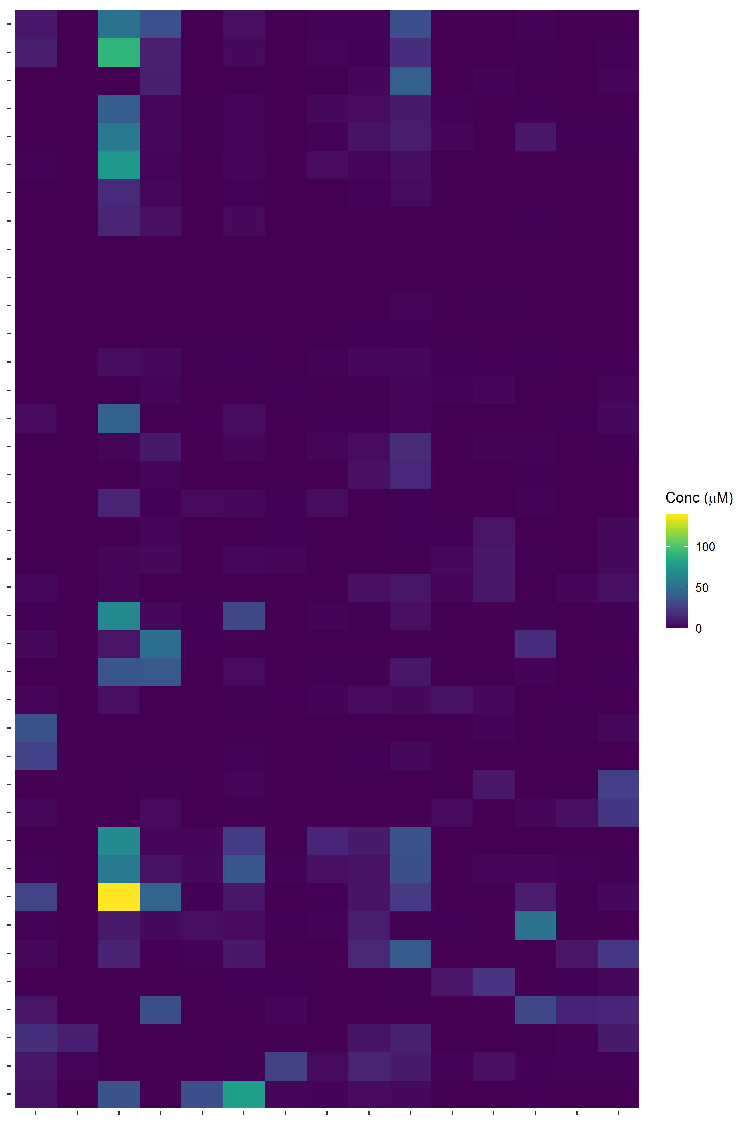
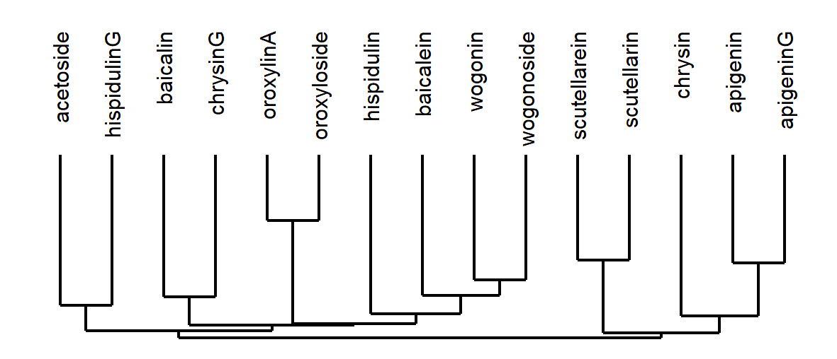
Chemical analysis
39 species selected for targeted profiling via HPLC
Order of species and flavonoids in heatmap determined by hierarchical clustering
Subset of species selected for organ-specific profiling

Slide 8
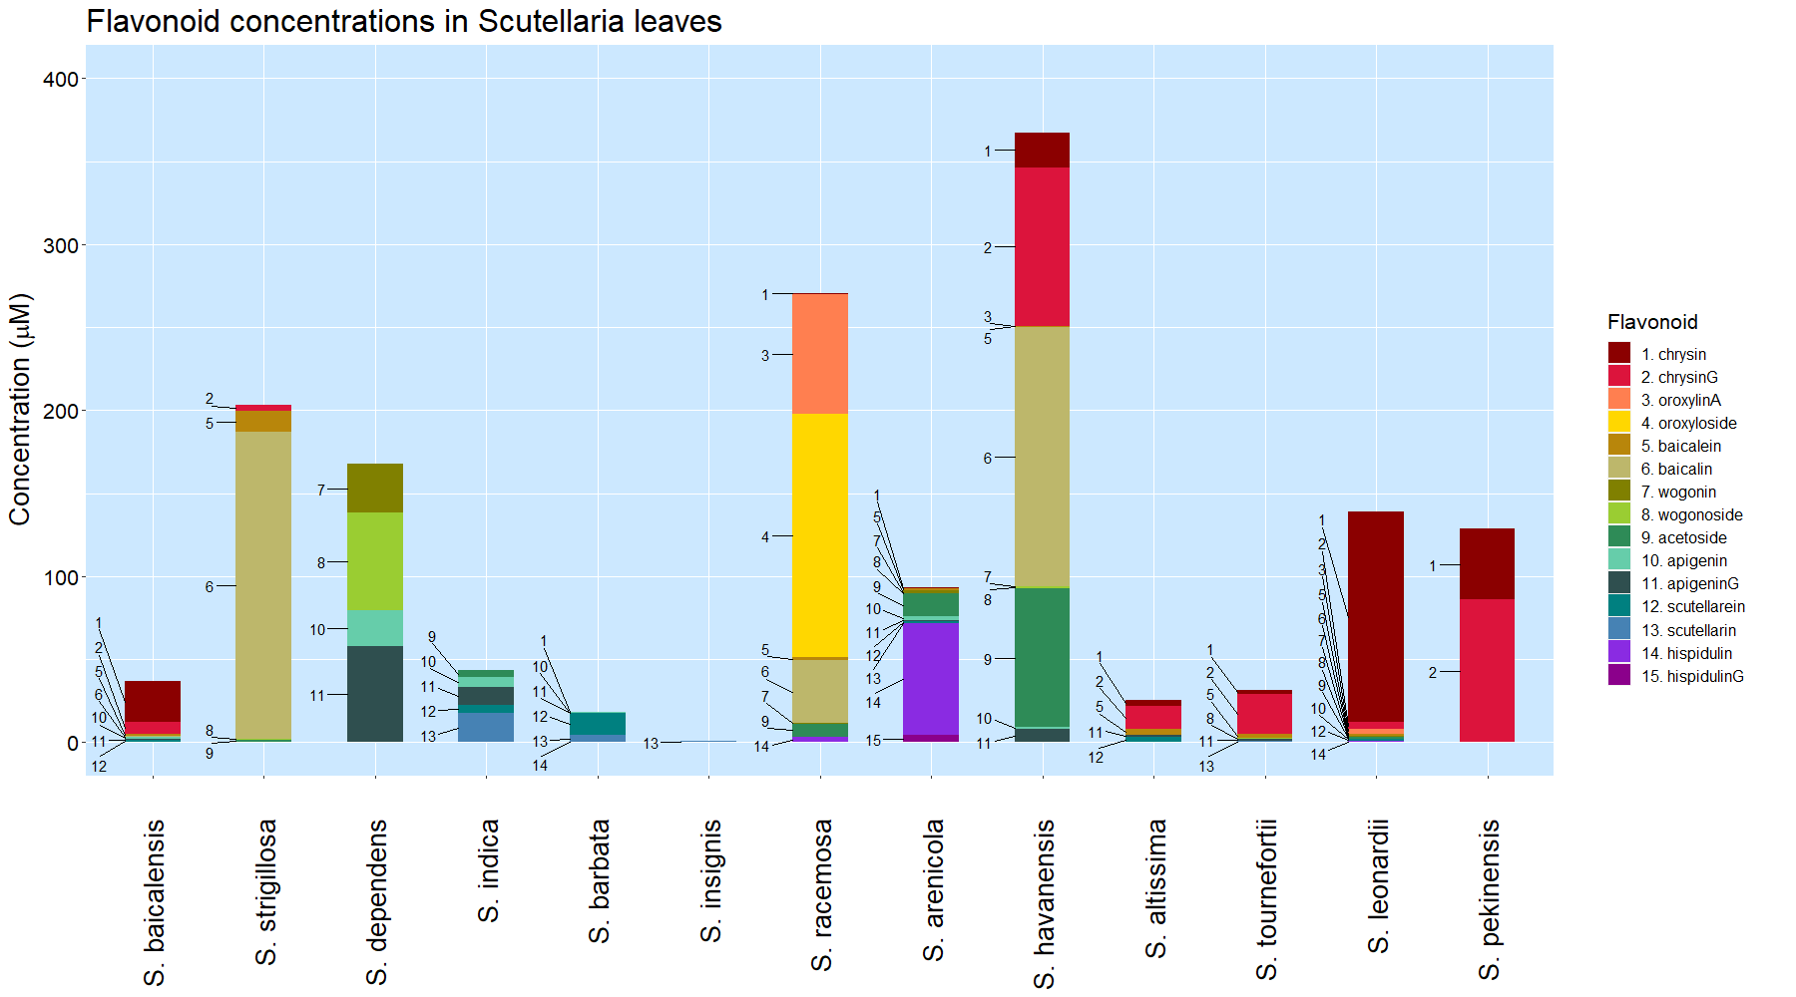
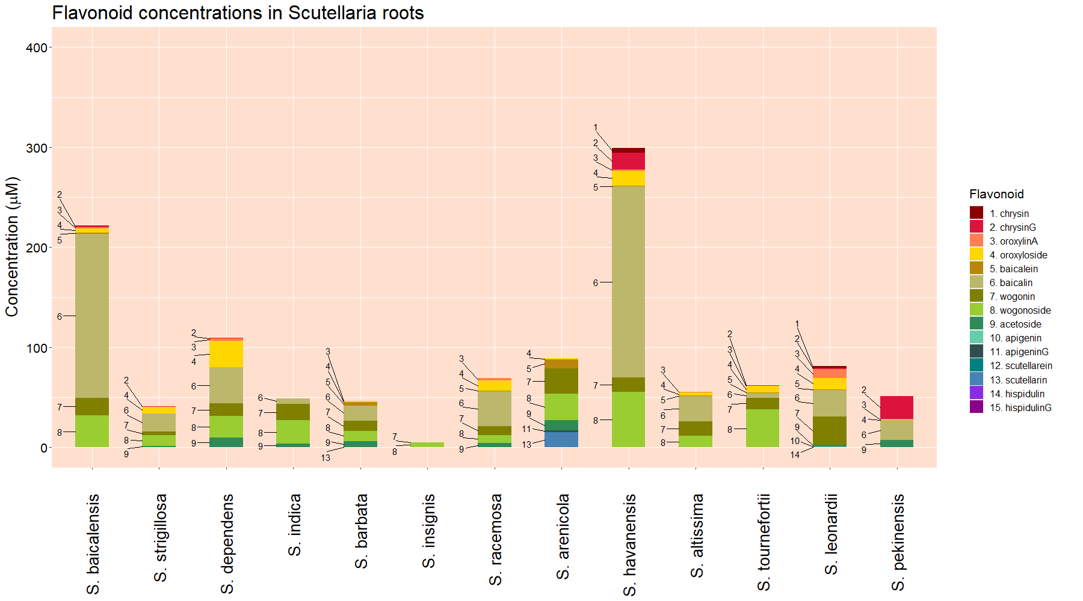

Slide 10
Proposed S. baicalensis biosynthetic pathway
Scutellarin
4-coumarate
Apigenin
Scutellarein
Hispidulin
HispidulinG
Phenylalanine
Cinnamic acid
Oroxylin A
Oroxyloside A
Baicalein
Baicalin
Cinnamoyl-CoA
Chrysin
Norwogonin
Wogonin
Wogonoside

Slide 11
Species | Estimated genome size (Gbp) |  | Chromosome number
 | Measured in this study | Published previously | Published previously
S. baicalensis | 0.54 | 0.38 (Xu et al., 2020) | 2n = 18 (Xu et al., 2020)
 |  | 0.41 (Zhao et al., 2019) | 2n = 18 (Zhao et al., 2019)
 |  | 0.41 (Cole et al., 2008)
S. strigillosa | n.d. | 0.38 (Lee & Kim, 2017)
S. dependens | 0.44
S. indica var. coccinea | n.d. | 0.38 (Lee & Kim, 2017)
S. barbata | 0.52 | 0.35 (Xu et al., 2020) | 2n = 26 (Xu et al., 2020)
S. insignis | n.d. | 0.46 (Lee & Kim, 2017)
S. racemosa | 0.44 | 0.37 (Cole et al., 2008) | 2n = 18 (Cole et al., 2008)
S. arenicola | 0.85
S. havanensis | 0.37
S. altissima | 0.39
S. tournefortii | 0.39
S. leonardii | 0.50
S. pekenensis | 0.38 | 0.45 (Lee & Kim, 2017)

Slide 12
Discussion

Slide 13
References

Slide 14
Acknowledgements

